Slide 1


Support Bayside BEC offers to Small Businesses
www.baysidebec.com.au

Slide 2


Some of the business support options Bayside BEC offers.
Membership & Networking
Bayside BEC offers membership and networking opportunities.
Members gain access to a large library of resources, workshops, and networking opportunities. As well as access to business coaching & advice.
Business Coaching & Start Up Advice
Bayside BEC also offers business advice, coaching & help for businesses and start-ups.
Some clients may be eligible for the Digital Solutions Program, which gives them to access a 7- hour package of 3 hours of free 1 – 1 business advice and 4 hours of webinars.
Digital Solutions Program
Is a federally funded program to assist small businesses.
It gives small businesses with less than 20 staff, & a valid ABN that are based in NSW or ACT, and who have not previously accessed the ASBAS program, a package to help them to increase their digital presence.

Slide 3

Digital Solutions Package
Delivered by
Bayside BEC
The package is currently FREE due to Covid and consists of the following:
Half an hour digital assessment & plan
3 hours of one on one business advice with an expert advisor
4 hours of workshops offered under the program

Slide 4

To sign up for the package go to www.baysidebec.com.au
Currently due to Covid lockdown the Digital Solutions Program is free to eligible businesses.
The normal price is $44, for the 7-hour package. This is a heavily subsided rate, that can only be offered once under the program.
A wide range of topics are covered under the program, designed to assist small businesses.

Slide 5

What kind of topics are covered under the program ?
How digital tools can help your small business
Websites and selling online
Social media and digital marketing
Using small business software
Online security and data privacy.
Digital Solutions is a 7-hour packaged service that offers 3 hours of one-on-one tailored support as well as group workshops or webinars.

Slide 6

Who can register and access the program?
Small businesses based in NSW or ACT with fewer than 20 full-time (or equivalent) employees, as well as sole traders, can access services at the subsidised rate.
How Much does it cost ?
The Digital Solutions program is $44 for 7 hours of support and your first interaction with the service is free.
Currently however this fee is being waived due to Covid.

Slide 7
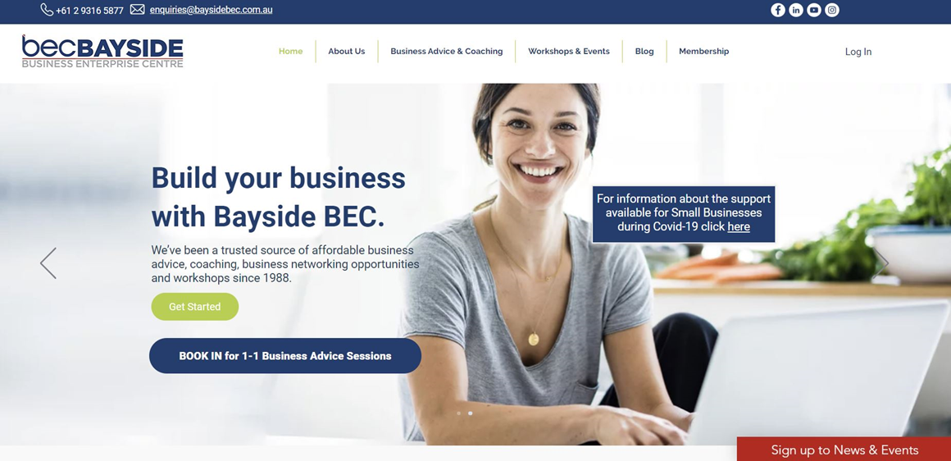
www.baysidebec.com.au
Go to our website to find out more or register.
Or email us at enquiries@baysidebec.com.au

